Slide 1
Genitourinary Trauma in the Emergency Department
Tran Duc Lai, MD
Hue University Hospital
James Ramseier, MD
Las Vegas, USA

Slide 2
Epidemiology
Injury frequency of abdominal organs:
Splenic injuries—25%
Liver injuries—15-20%
Renal Injuries—10%
Most common between 20-35 years of age
More common in men
Mechanism
Blunt—90%
Penetrating—10%

Slide 3
Anatomy
Upper Urinary Tract
Kidney
Ureter
Lower Urinary Tract
Bladder
Urethra

Slide 4
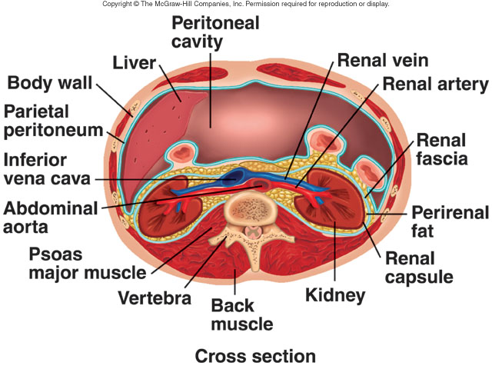
Anatomy

Slide 5
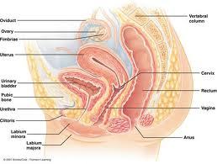
Anatomy

Slide 6
Prehospital Care
No specific intervention is needed
One exception…
Penile amputation
Direct pressure to stop bleeding
Wrap amputated penis in sterile dressing
Place in container of ice– not in direct contact with ice

Slide 7
History
GU tract assessed during secondary survey
Mechanism of Injury—blunt vs. penetrating
Past medical history
Problems with renal function
High risk for renal insufficiency (diabetes, hypertension
Uninephric
Gross hematuria
Difficulty voiding since injury

Slide 8
Physical Exam
Flank exam
Risk stratifies injury to kidneys
Tenderness, palpable mass, ecchymosis
Costal margin exam
Injury to kidneys, spleen, and liver
Thoracolumbar spine exam
Palpation to identify potential fractures
Transverse spine fracture→ higher risk of renal injury
Back exam for ecchymosis
Pelvic stabilility
Instability increases risk of bladder injury

Slide 9
Physical Exam
Rectal exam
May not be useful in all trauma patients
Reserved for patients with:
Pelvic fractures
Evaluates prostate: high riding/boggy→? urethral injury
Penetrating wound to lower abdomen
Evaluate rectal tone when spinal cord injury suspected
Perineal exam
Hematoma and edema
Suggests possible urethral injury
External genitalia exam
Penile injury: edema, laceration, deformity
Urethral injury: blood at meatus
Testicular injury: edema, laceration, deformity

Slide 10
Foley Catheter Placement
Indications in critical patient:
Test for hematuria
Monitor urine output
Ease of urination
Contraindications→ Retrograde urethrogram
Blood at urethral meatus
Boggy/high-riding prostate
Perineal hematoma
Difficulty catheterization→ Retrograde urethrogram
Urethral injury
Urethral stricture
Prostatic hypertrophy
Cancer

Slide 11
Urinalysis
GU trauma screening test→ UA for hematuria
Urine β−hCG for pregnancy status
Gross hematuria
Renal injuries 50%
Renal injuries without hematuria 5%
Renal artery injury
Disruption of the uteropelvic junction
Evaluate GU tract and other abdominal organs
CT scan with delayed images: kidneys +abd organs
Cystogram: bladder

Slide 12
Urinalysis
Microscopic hematuria
Pediatric population
Routinely used but controversial
Cutoff levels of 5-50 RBC/hpf used for additional abdominal imaging
Vast majority of GU injuries have >50 RBC/hpf
Adult population
Controversial
Cutoff levels of >10 –>25 RBC/hpf used for additional abdominal imaging

Slide 13
Urinalysis
Microscopic hematuria
Adult population
Standard based on old studies that attempted to identify renal injury requiring intervention
Blunt trauma patient needs upper urinary tract imaging if…
Gross hematuria
Microscopic hematuria and shock
These studies did not take in to account:
Renal injuries not requiring intervention
Ability of microscopic hematuria to account for non-GU injuries
The ability of microscopic hematuria to detect lower urinary tract injuries
Degree of hematuria requiring abdominal imaging varies from >10 RBC/hpf to >25 RBC/hpf
Consider the whole picture: degree of hematuria, mechanism of action, and additional physical exam findings

Slide 14
Additional Labs
Complete blood count
Type and screen
BUN and Creatnine levels
Increase with:
Renal injury
Ureter/bladder injury
CT abdomen with contrast
X-ray
Ultrasound

Slide 15
Specific Injuries & Treatment
Upper urinary tract
Renal injuries
Lumbar spine fractures (esp. transverse process fractures)
Injury grade guides treatment
Grade I-III: non-operative repair in children and adults
Grade IV: half require surgery
Grade V: all require surgery
Acute complications
Hemorrhage, urinoma, hydronephrosis, arterial pseudoaneurysm, infection
Long-term complications
Renal failure, hypertension

Slide 16
Renal Injury Grading System
Grade | Description
I | Contusion or non-expanding subcapsular hematoma
II | Non-expanding perirenal haematoma, cortical laceration <1 cm deep without extravasation
III | Cortical laceration >1 cm without urinary extravasation or collecting duct rupture
IV | Laceration through corticomedullary junction into collecting system or renal artery or vein injury with contained hematoma
V | Shattered kidney or renal pedicle avulsion

Slide 17
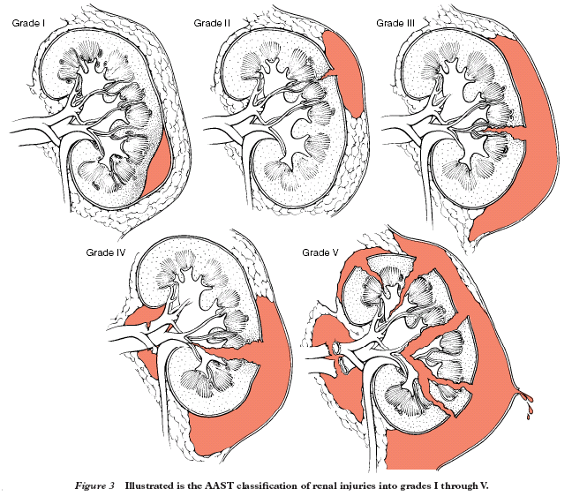
Renal Injury Grading System

Slide 18
Specific Injuries & Treatment
Renal injuries (cc)
Renovascular injuries
Most severe, but rare
Renal artery thrombosis most common
CT abdomen with contrast = screening test of choice
Renal pedicle contrast extravasation
Complete/focal non-enhancing kidney
Renal hilar hematoma
Hilar hematoma + normally enhancing kidney => renal vein injury

Slide 19
Specific Injuries & Treatment
Renovascular injuries (cc)
Treatment
Complete devascularization
Emergency— vascular repair attempted; most result in nephrectomy
Renal artery pseudoaneurysm/dissection
Angiographic embolization
Endovascular stent placement

Slide 20
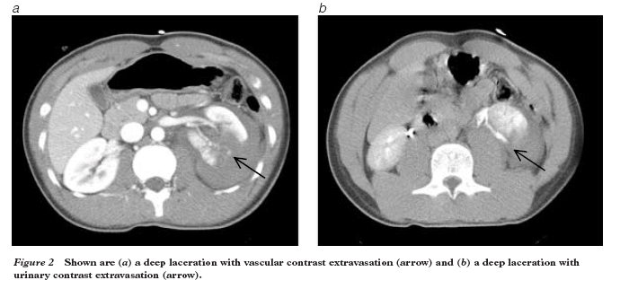
Renal Injury
Grade 4
Notes:
I think there may be too many examples. We can cut some of them out if the presentation is too long.

Slide 21
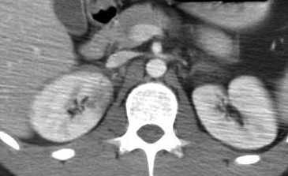
Renal Injury
Grade 1; contusion

Slide 22
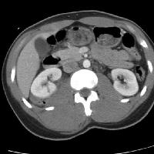
Renal Injury
Grade 3
Cortical laceration >1 cm

Slide 23
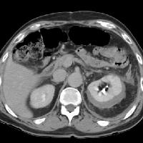
Renal Injury
Grade 1
Subcapsular hematoma

Slide 24
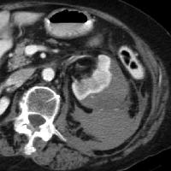
Renal Injury
subcapsular and
perinephric hematoma
Grade 2

Slide 25
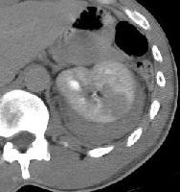
Renal Injury
Grade 3
Renal laceration
>1 cm

Slide 26
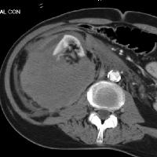
Renal Injury
Shattered kidney with large hematoma
Grade 5

Slide 27
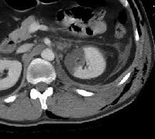
Renal Injury
Grade 4
Segmental infarction

Slide 28
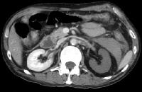
Renal Injury
Grade 5
Devascularization

Slide 29
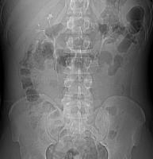
Renal Injury
Grade 3 renal laceration
Normal one-shot IVP

Slide 30
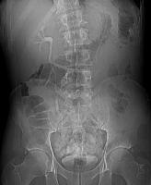
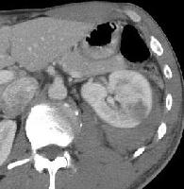
Renal Injury
Grade 3 renal laceration
Absent right nephrogram

Slide 31
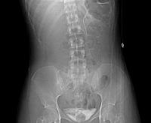
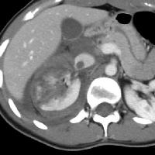
Renal Injury
Grade 5 injury; shattered right kidney
Absent right nephrogram

Slide 32
Specific Injuries & Treatment
Upper urinary tract (cc)
Ureteral injuries
Rare, 1% of GU injuries
Gunshot wounds 94%
Stab wounds 5%
Blunt trauma 1%
Sudden decelerating force
No specific physical exam findings
Hematuria 75%
Screening: CT abdomen with contrast and delay views
Grading: scale not well accepted
Diagnostic: Retrograde pyelography
Treatment: ureter with active extravasation of urine
Stenting, primary closure, ureteroneocystostomy
Ureteroureterostomy less frequent
Complications: urinoma, abscess, stricture, hydronephroma, fistula, ileus
Notes:
These injuries are RARE—1%. So, if the lecture is too long, we should remove this slide or make it much smaller.

Slide 33
Specific Injuries & Treatment
Lower urinary tract
Bladder injuries
Classic triad: gross hematuria, suprapubic pain, inability to void
Risk of injury increased
Pelvic fractures, pregnant (>1st trimester,) intoxicated
Hematuria
Gross hematuria in 67%
Injury rare when <25 RBC/hpf
Diagnosis
Bladder CT scan
Plain film cystogram
Delays may show increase in BUN & Creatnine

Slide 34
Specific Injuries & Treatment
Bladder injuries
Injury classification and treatment
Contusion/hematoma
Treatment: observe for resolution of hematuria
Intraperitoneal rupture
Sudden increase in intra-bladder pressure
Treatment: operative repair + urine catheter for 14 days + broad spectrum antibiotics
Repeat cystogram looking for urine leak
Catheter removed if no leak
Extraperitoneal rupture
Bony fragment laceration; sheering force
Treatment: observe for 7 days + urine catheter
Evaluation for resolution of hematuria
No hematuria→ repeat cystogram
Complications: infection, urinoma, inability/difficulty voiding, fistula
Emergency department visit post-op with urinary retention
Place urine catheter after consulting urologist
Check urine for infection

Slide 35
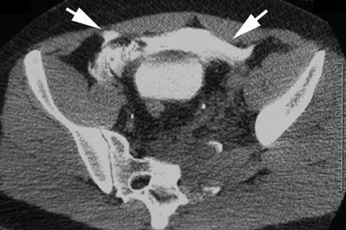
Bladder Injury
Extraperitoneal rupture
Notes:
Again, maybe to many examples. We can remove some of the examples if the lecture is too long.

Slide 36
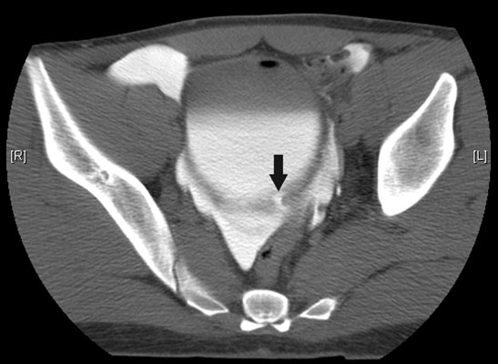
Bladder Injury
Intraperitoneal rupture

Slide 37
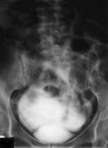
Bladder Injury
Extraperitoneal rupture
Notes:
Difficult to interpret. Poor image quality.

Slide 38
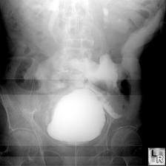
Bladder Injury
Intraperitoneal rupture
Notes:
Bowel wall is outlined and contrast is tracking up the left paracolic gutter.

Slide 39
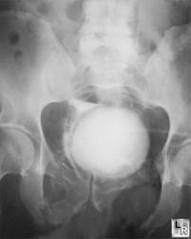
Bladder Injury
Extraperitoneal rupture
Notes:
Fluid outlining the lateral aspects of the bladder in the retroperitoneal space.

Slide 40
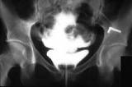
Bladder Injury
Intraperitoneal rupture
Notes:
Fluid outlines the bowel wall.

Slide 41
Specific Injuries & Treatment
Urethral injuries
Rare; male 95%
Risk increased with
Pelvic fractures: pubic symphysis and sacroiliac diastasis, straddle fracture, Malgaigne fracture
Straddle injuries
Penetrating trauma close to urethra
Penile fracture
Physical exam:
Blood at urethral meatus, perineal hematoma/edema, high riding prostate on rectal—rare
Gross hematuria—common

Slide 42
Specific Injuries & Treatment
Urethral injuries (cc)
Gross hematuria + difficulty placing catheter => urethral evaluation
Extension of urethral laceration, increase bleeding, contamination of hematoma
Grading system exists but is not well accepted
Injury severity determined by:
Location of the injury
Complete vs incomplete transection of the urethra
Diagnosis: Retrograde urethrogram
Treatment: if urethra is injured, consult urology

Slide 43
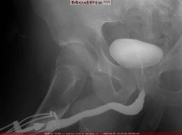
Urethral Injury
Normal

Slide 44
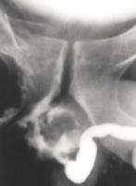
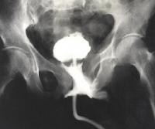
Urethral Injury
Partial urethral disruption
Complete urethral disruption

Slide 45
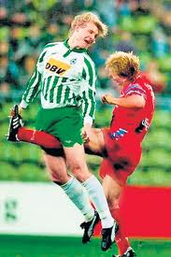
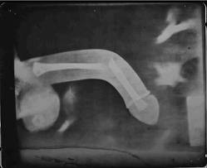
Specific Injuries & Treatment
External genitalia injuries
Penile laceration
Superficial penile laceration→ repair in emergency dept.
Complex penile laceration→ consult urology
Compromised Buck’s fascia→ consult urology
Penile fracture
Occur during coitus or masturbation
Presentation: penile pain, loss of erection, deformity, swelling, difficulty voiding
Treatment:
Involvement of corpus caverosum or Bucks fascia (common)→ operative intervention
Superficial to Bucks fascia (less common)→ nonoperative management
Notes:
The picture of the fractured penis is funny. But I think you should talk seriously so everyone thinks you think it is real. On the next slide you can say it was a joke. This helps everyone laugh a little.

Slide 46
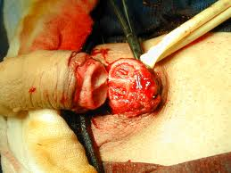
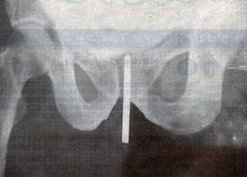
Specific Injuries & Treatment
External genitalia injuries (cc)
Penile amputation
Treatment: reimplantation if warm ischemic time <6 hours
In emergency department, penis is kept cold (wrapped in dry gauze on ice,) and urology consulted immediately
Penile foreign bodies
Blunt foreign bodies in the distal urethra→ removal in the emergency department
Sharp, not easily visualized in the proximal urethra→urology consultation for operative intervention
Complication: strictures, impotence, incontinence

Slide 47
Specific Injuries & Treatment
Testicular injuries
Uncommon; blunt trauma 85%
Testicular rupture: most serious injury
Hematocele: hemorrhage in to the tunica vaginalis
Testicular dislocation: rare; manual reduction in the emergency department recommended
Diagnosis: Ultrasound study of choice
Treatment
Nonoperative intervention for minor injuries
Scrotal elevation, ice, non-steroidal antiinflammatory drugs, limited activity
Operative intervention
Testicular rupture
Expanding hematocele
Inability to reduce testicular dislocation
Scrotal degloving
Testicular salvage as low as 40%
Complications: bleeding, abscess, skin necrosis, infertility, testicular atrophy, testicular necrosis

Slide 48
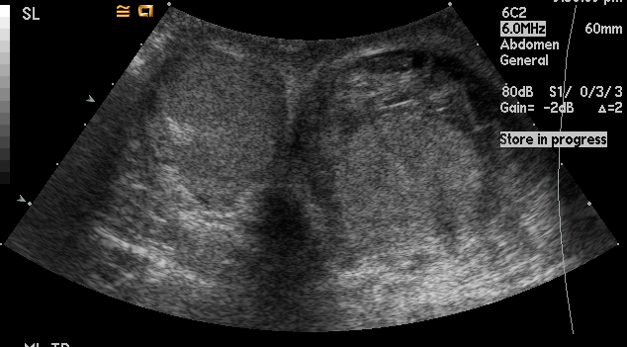
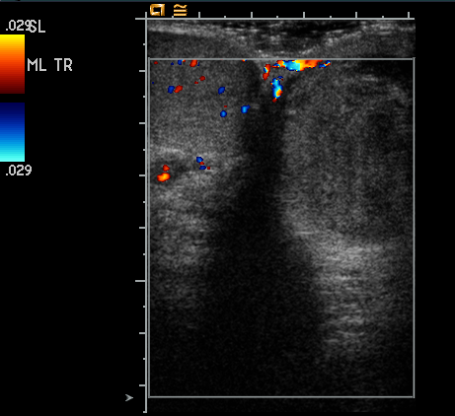
Testicular Injury
Injured or uninjured?
Notes:
Top right picture: left testicle OK (smooth contour), right testicle injured (irregular contour and edema.) Bottom left picture: doppler ultrasound to evaluate blood flow to the testicles– Left testicle OK (blood flow seen in the testicle), right testicle has no blood flow, no color in the testicle. Depending on the time, you can present the slides and ask with testicle they think is OK and which one they think is injured. You can also ask them explain their choice. If you don’t have time, simply tell them what they are looking at.

Slide 49
Summary
Kidneys are the 3rd most commonly injured abdominal organ
Specific GU track injury is evaluated during the secondary survey
Most renal injuries are minor with no long term complications
Gross hematuria OR microhematuria + shock = GU trauma
Renovascular injuries require prompt diagnosis and urological consultation
Pelvic fracture + >25 RBC/hpf => consider bladder injury
Blood at urethral meatus, perineal hematoma, high-riding prostate => consider urethral injury
Imaging selection:
Renal→ CT abdomen with delayed images; one-shot IVP; ultrasonography
Ureteral→ one-shot IVP
Bladder→ plain film cystogram; CT cystogram
Urethral→ retrograde urethrogram
Testicular→ ultrasound

Slide 50
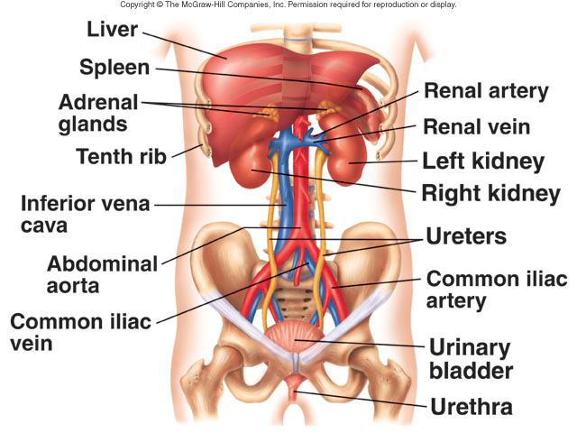
Questions?

